Slide 1
Scaled Agile Framework

Slide 2

Keeping Pace
Our development methods must keep pace with an increasingly complex world driven by software
We’ve had Moore’s Law for hardware and now software is eating the world
Our development practices haven’t kept pace. Agile shows the greatest promise, but was developed for small teams
We need a new approach that harnesses the power of Agile and Lean and applies to the needs of the largest software enterprises

Slide 3

We thought we’d be programming like this

Slide 4
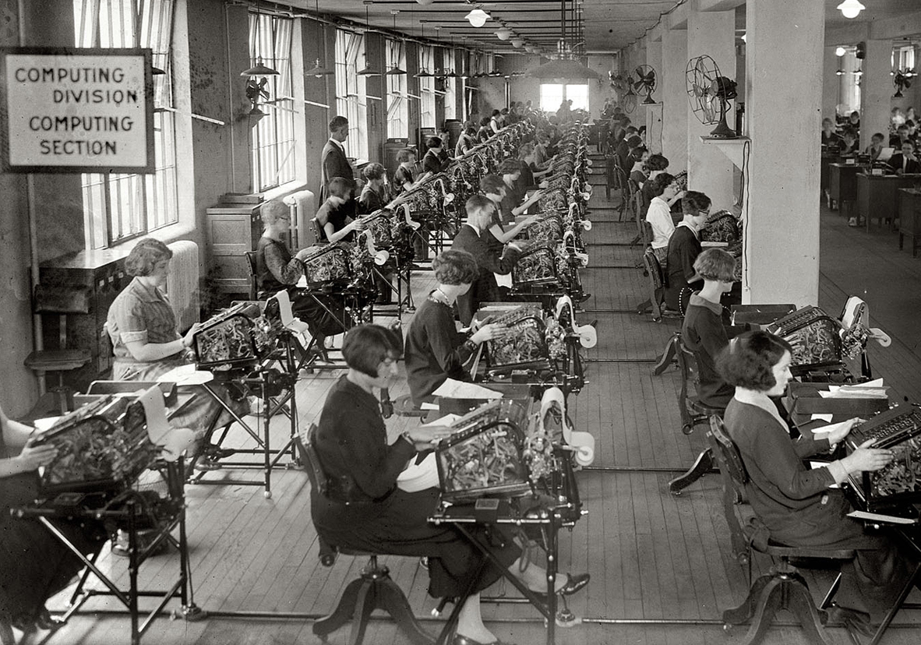
But sometimes it feels like this

Slide 5
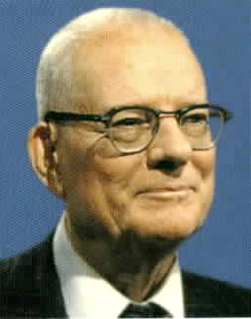
The Management Challenge
If you can’t change the system, who can?
“It is not enough that management commit themselves to quality and productivity, they must know what it is they must do.”
—W. Edwards Deming

Slide 6
Be Agile

Slide 7







A Stark Choice of Approaches
Requirements
Design
Implementation
WATERFALL
Verification
4
444
:
Documents
Documents
Unverified Code
Software
AGILE

Slide 8
Makes Money Faster
Market value of a feature over time
Agile cumulative margins
VALUE DELIVERY
Waterfall margins begin here
TIME

Slide 9
Scale Up

Slide 10
Scaling, Another Stark Choice
You have a blank slate.
Figure out what works for you.

Slide 11
Or Start with a Proven Framework
A proven, publicly-facing framework for applying Lean and Agile practices at enterprise scale
CORE VALUES
Program Execution
Alignment
Code Quality
Transparency
Synchronizes alignment, collaboration and delivery for large numbers of teams
ScaledAgileFramework.com

Slide 12
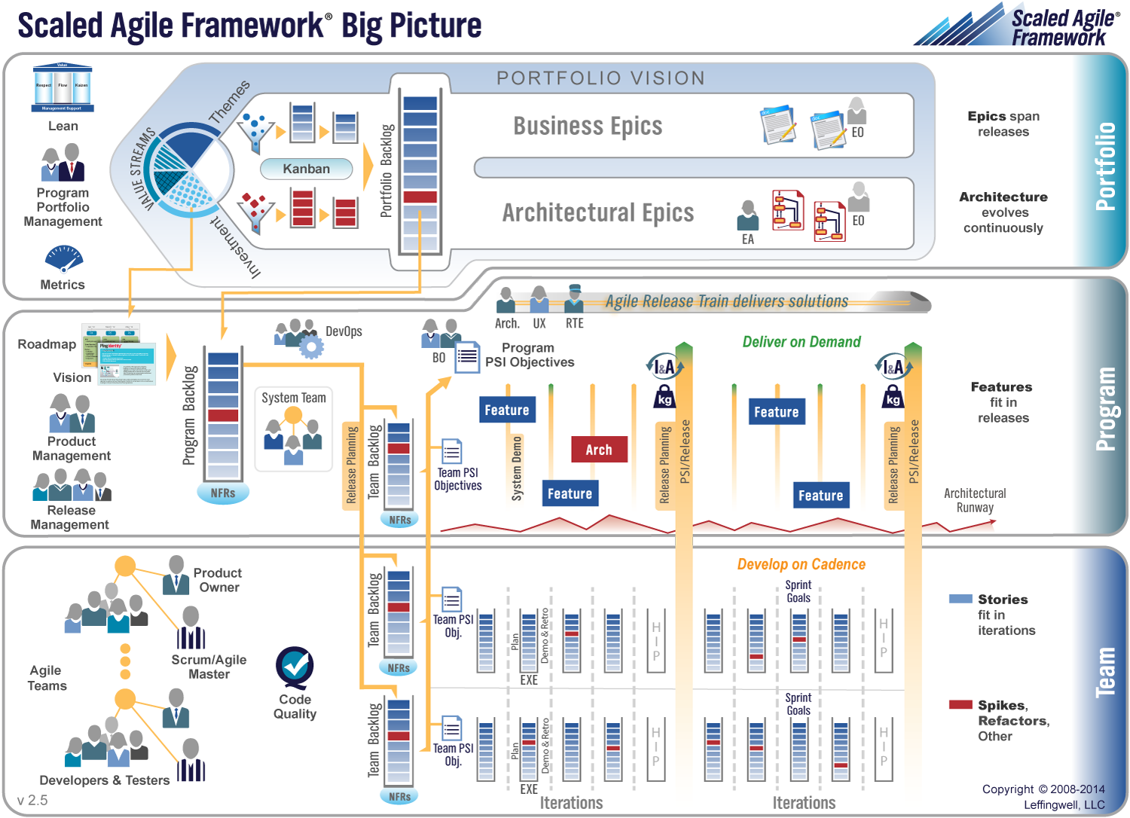

Slide 13
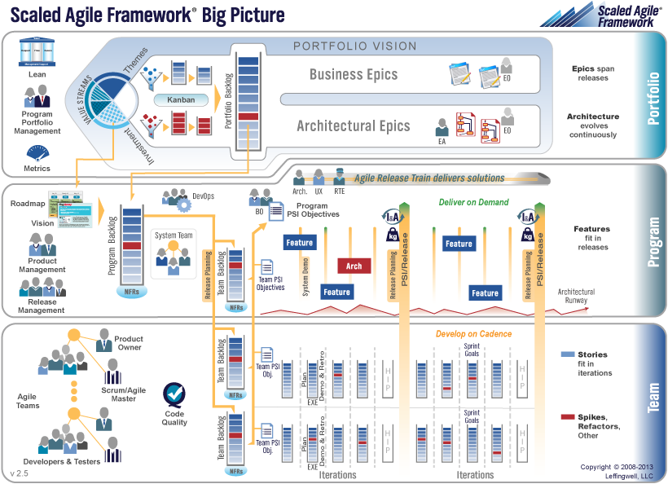
SAFe Delivers Business Results
Increase in employee engagement
30-75% faster time to market
ENGAGEMENT
TIME TO MARKET
PRODUCTIVITY
BUSINESS RESULTS
QUALITY
20-50% increase in productivity
50%+ defect reduction

Slide 14
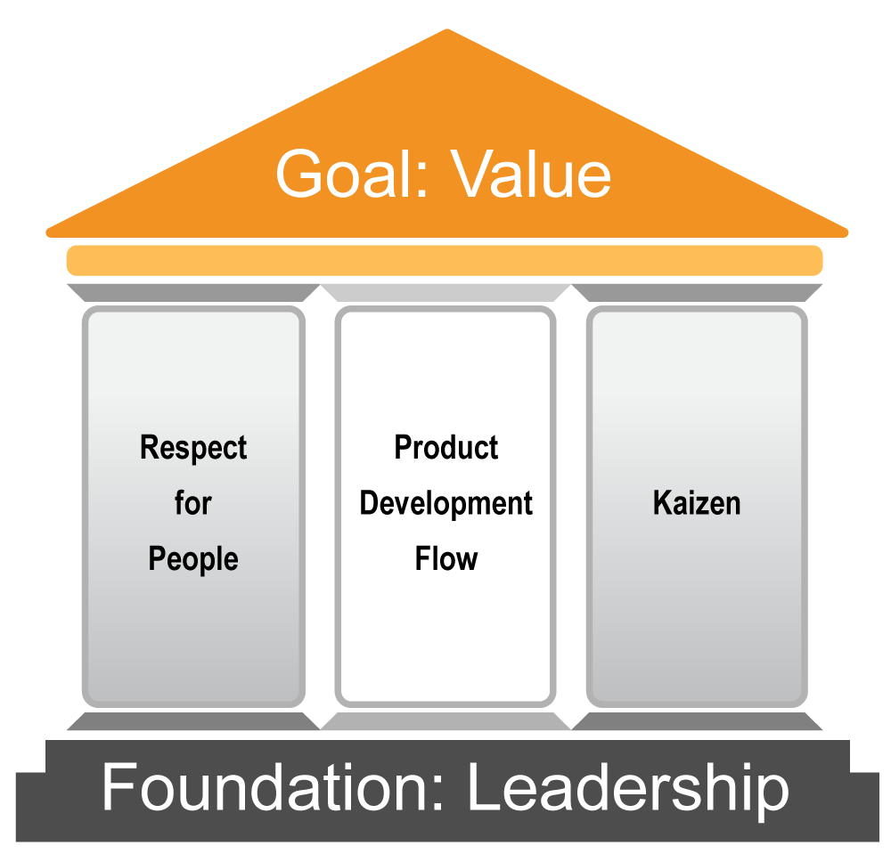
Lean Thinking Provides the Tools We Need

Slide 15
Goal: Speed, Quality, Value
Minimize delays, handoffs and non-value added activities
All we are doing is looking at the timeline, from the where the customer gives us an order to where we collect the cash. And we are reducing the time line by reducing the non-value added wastes. —Taiichi Ohno We need to figure out a way to deliver software so fast that our customers don’t have time to change their minds. —Mary Poppendieck
Most software problems will exhibit themselves as a delay. —Al Shalloway
The Goal
Sustainably shortest lead time
Best quality and value to people and society
Most customer delight, lowest cost, high morale, safety

Slide 16
Respect for People
People do all the work
Your customer is whoever consumes your work
Don’t trouble them
Don't overload them
Don't make them wait
Don't impose wishful thinking
Don't force people to do wasteful work
Equip your teams with problem-solving tools
Form long-term relationships based on trust
People
Develop individuals and teams; they build products
Empower teams to continuously improve
Build partnerships based on trust and mutual respect

Slide 17
Kaizen
We can do better
A constant sense of danger
Small steady, improvements
Consider data carefully, implement change rapidly
Reflect at milestones to identify and improve shortcomings
Use tools like retrospectives, root cause analysis, and value stream mapping
Protect the knowledge base by developing stable personnel and careful succession systems
Become Relentless In:
Reflection
Continuous improvement as an enterprise value

Slide 18

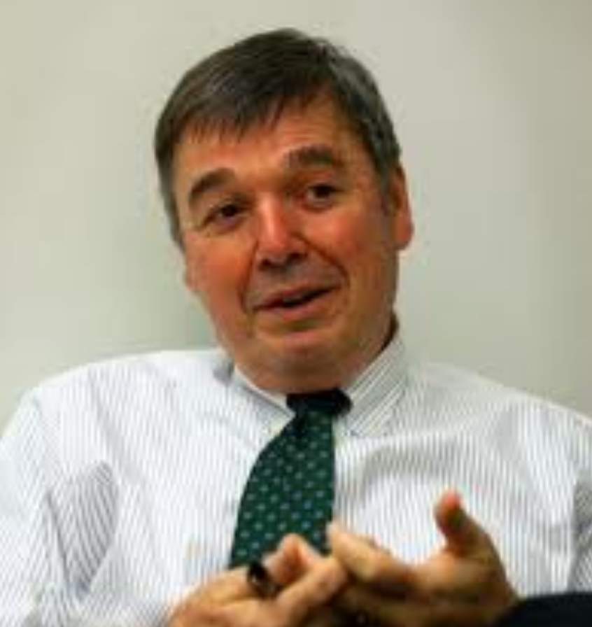
Product Development Flow
Principles
Take an economic view
Actively manage queues
Understand and exploit variability
Reduce batch sizes
Apply WIP constraints
Control flow under uncertainty: cadence and synchronization
Get feedback as fast as possible
Decentralize control
Don Reinertsen
Principles of Product Development Flow

Slide 19
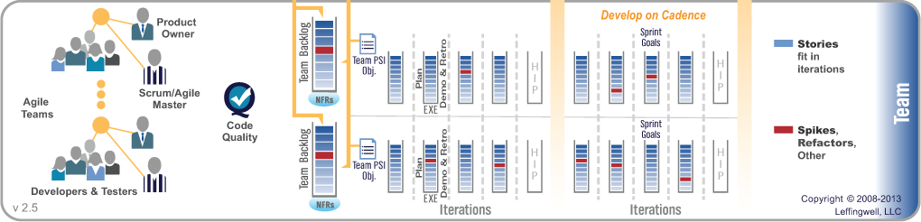
Nothing Beats an Agile Team
Valuable, fully-tested software increments every two weeks
Empowered, self-organizing, self-managing cross-functional teams
Teams operate under program vision, architecture and user experience guidance
Scrum project management and XP-inspired technical practices
Value delivery via User Stories

Slide 20

That Focuses on Code Quality
You can’t scale crappy code
Agile Architecture
Code Quality Provides
Higher quality products and services, customer satisfaction
Predictability and integrity of software development
Development scalability
Higher development velocity, system performance and business agility
Ability to innovate
Continuous Integration
Test-First
Refactoring
Pair Work
Collective Ownership

Slide 21
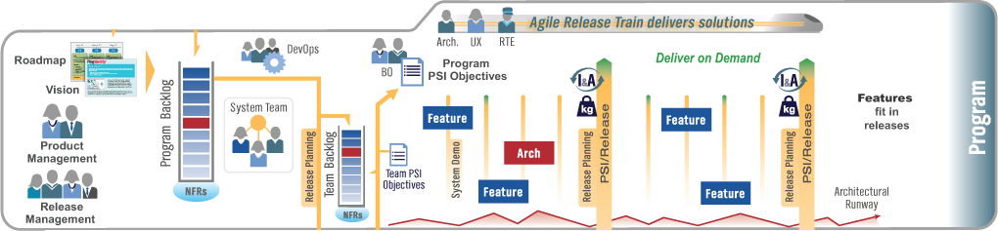
Scale to the Program Level
Self-organizing, self-managing team-of-agile-teams
Working, system-level software at least every two weeks
Aligned to a common mission via a single backlog
Common sprint lengths and estimating
Face-to-face planning cadence for collaboration, alignment, synchronization, and assessment
Value Delivery via Features and Benefits

Slide 22
Develop on Rhythm. Deliver on Demand.
Development occurs on a fixed pace. The business decides when value is released.
Major
Release
Major
Release
Customer Preview
Customer Upgrade
New
Feature
Deliver on Demand
PSI
PSI
PSI
PSI
PSI
Develop on Rhythm

Slide 23
Stay Lean

Slide 24
Scaling to the Portfolio
“A system is a network of interdependent components that work together to try to accomplish the aim of the system.
A system must have an aim. Without an aim, there is no system.”
—W. Edwards Deming

Slide 25
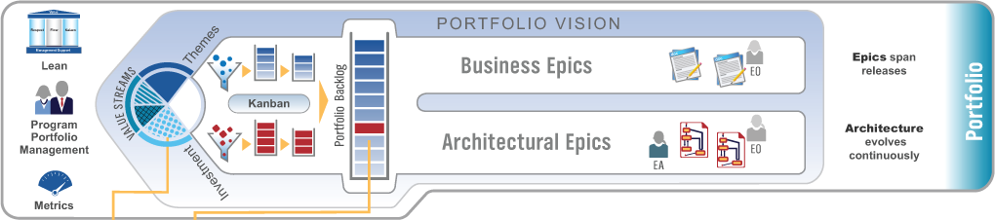
Scale to the Portfolio
Centralized strategy, decentralized execution
Lean budgeting at the Program level
Kanban systems provide portfolio visibility and WIP limits
Enterprise architecture is a first class citizen
Objective metrics support governance and kaizen
Value description via Business and Architectural Epics

Slide 26
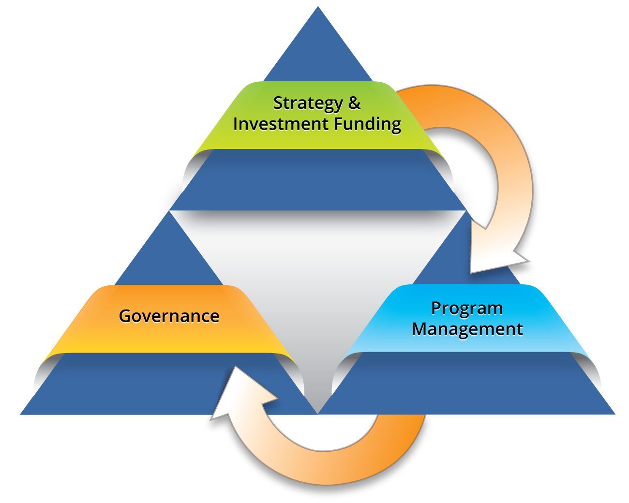
Agile Program Portfolio Management
Fulfills its responsibilities while enabling lean and agile practices for better business results
Decentralized decision-making
Demand management; continuous value flow
Lightweight epic business cases
Decentralized, rolling-wave planning
Agile estimating and planning
Self-managing Agile Release Trains
Objective, fact-based measures and milestones

Slide 27
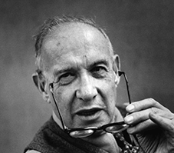
On “Managing” Knowledge Workers
Workers are knowledge workers if they know more about the work they perform than their bosses.
Workers themselves are best placed to make decisions about how to perform their work.
To effectively lead, the workers must be heard and respected.
Knowledge workers have to manage themselves. They have to have autonomy.
Continuing innovation has to be part of their work, the task, and the responsibility of knowledge workers.
—Peter Drucker

Slide 28
Lean Foundation: Leadership
Lean-Agile Leaders
Take a Systems View
Embrace the Agile Manifesto
Implement Product Development Flow
Unlock the Intrinsic Potential of Knowledge Workers
Management is trained in lean thinking
Bases decisions on this long term philosophy

Slide 29
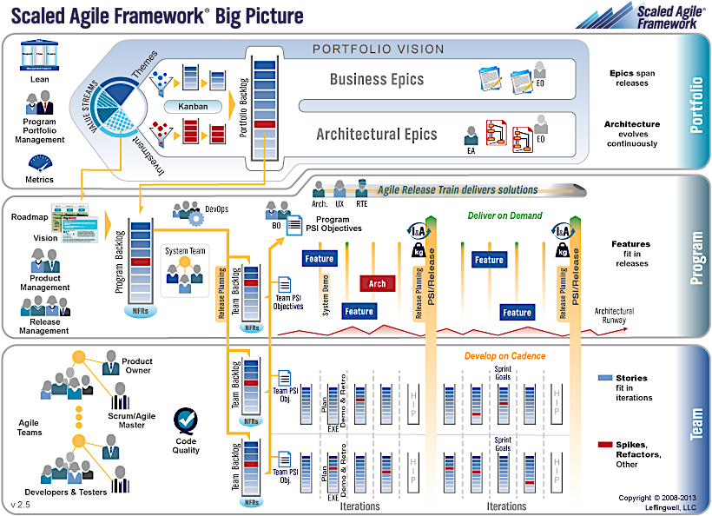
Conclusion
The foundation of Lean is LEADERSHIP
The foundation of SAFe is YOU

Slide 30
Next Steps

Slide 31



Next Steps
Become a SAFe
Lean-Agile Leader
Browse the framework
Read the book
Build your expertise with training and certification
Launch Agile
Release Trains
Accelerate value delivery with your first Agile Release Train
Leverage the
Community
Get help from the experts at ScaledAgile.com and ScaledAgilePartners.com
Join the community at community.ScaledAgile.com

Slide 32
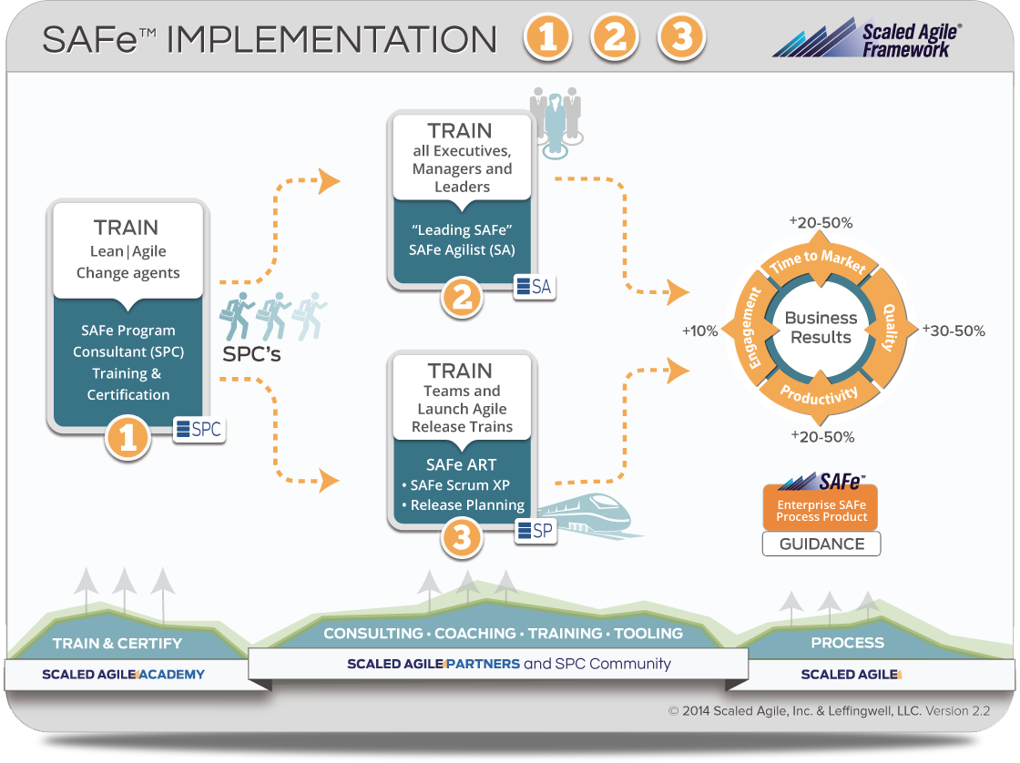

Slide 33
Appendix

Slide 34
References
This presentation was prepared after taking references from below sites:
http://scaledagileframework.com/
www.Rallydev.com

Slide 35

SAFe™ Reference
ScaledAgileAcademy.com
ScaledAgile.com/ESAFe
ScaledAgile.com/ART
ScaledAgilePartners.com
community.scaledagile.com
ScaledAgileFramework.com
Browse the Framework
Read the Book
Agile Software Requirements
Get Training, Certification and Courseware
Adapt it to your Enterprise with Enterprise SAFe™
Launch an Agile Release Train
Get help from the experts and the extensive service delivery Partner community
Join the Scaled Agile Framework
Community

Slide 36
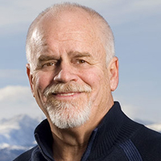
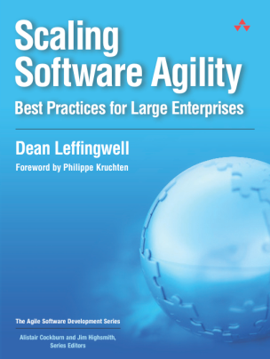
Framework Creator: Dean Leffingwell
Author
Creator: Scaled Agile Framework
Agile Enterprise Coach To some of the world’s largest enterprises
Agile Executive Mentor BMC, John Deere
Chief Methodologist Rally Software
Cofounder/Advisor Ping Identity, Roving Planet, Silver Creek Systems, Rally Software
Executive
Coach
Founder and CEO ProQuo, Inc., Internet identity
Senior VP Rational Software Responsible for Rational Unified Process (RUP) & Promulgation of UML
Founder/CEO Requisite, Inc. Makers of RequisitePro
Founder/CEO RELA, Inc. Colorado MEDtech

Slide 37

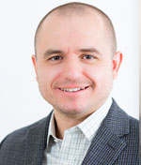
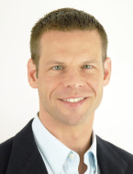
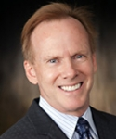
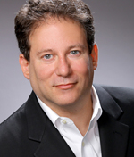


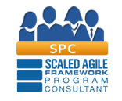
Contributors
Associate Methodologist
Principal Contributors
Alex Yakyma
Drew Jemilo
Colin O’Neill
Richard Knaster
Alan Shalloway
Acknowledgements
Enterprise
Adopters
Community

Slide 38
Some Thoughts on Agile Methods
Scrum
Works great. Less filling. Ubiquitous. Scrumptious. Let’s Sprint.
Extreme Programming
Really great code from really great coders. We can scale great code. Extremely useful. Let’s Program with it.
Kanban
Clear thinking on flow, demand management and limiting wip. Let’s flow, limit WIP and manage demand with it.
But if these innovative methods don’t have the native constructs to address the view beyond the team − the systems view − shouldn’t we do something about that?
And, on behalf of millions of practitioners, working on really big systems in really big companies, and struggling badly with existing approaches, don’t we have an obligation to try?

Slide 39
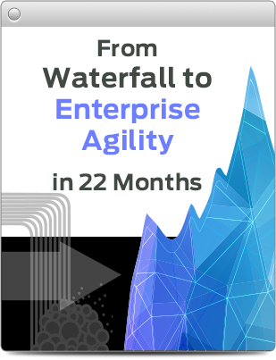



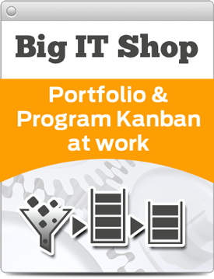
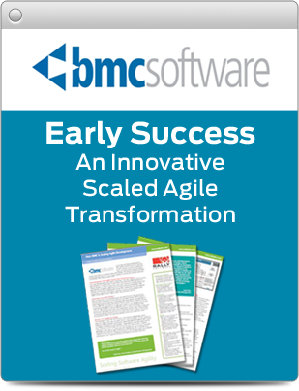
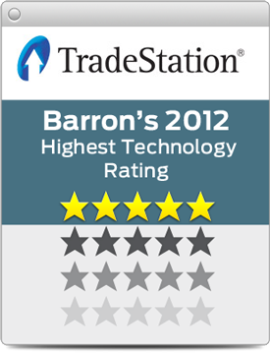
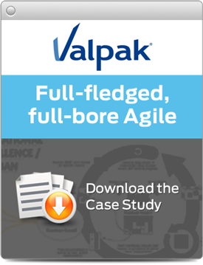


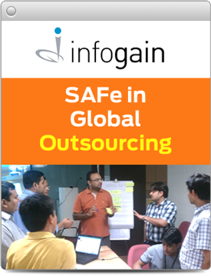
Case Studies
ScaledAgileFramework.com/case-studies

